Slide 1

AI & ML Laboratory Project on HOUSE PRICE PREDICTION
SYED.UZMA YASMIN 2203A52055
YENAGANDULA RAMYA 2203A52064
KOTHAPALLY PAVITHRA 2203A52095
- UNDER THE GUIDANCE OF
Dr .Soumik Podder
School of Computer Science & Artificial Intelligence
SR University
2024
/

Slide 2
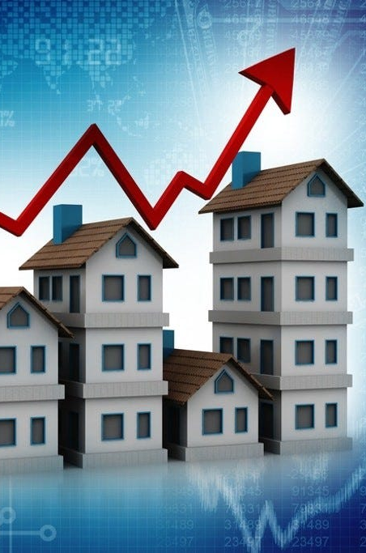


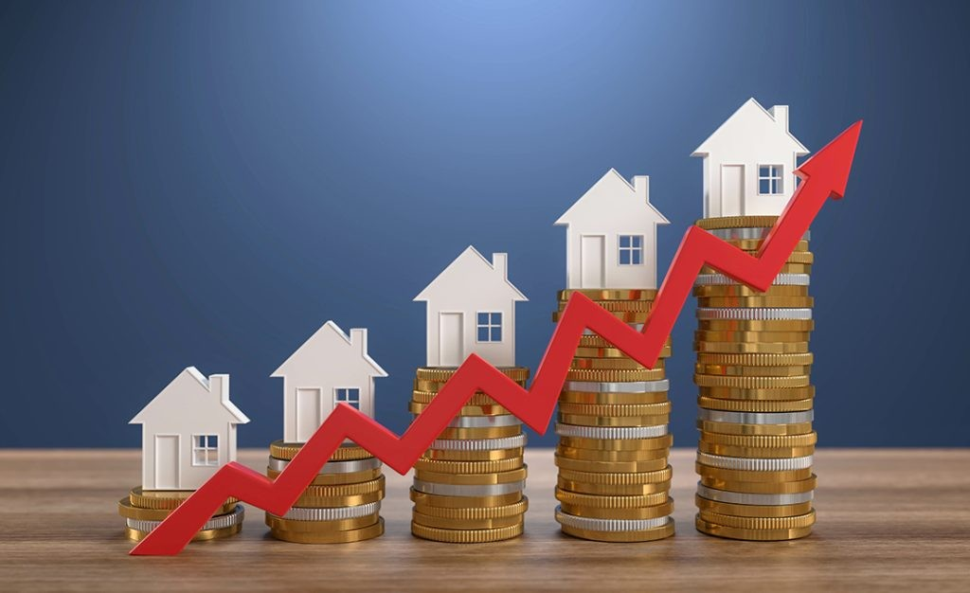

HOUSE PRICE PREDICTION
Exploratory Data Analysis and Machine learning on House Price Prediction

Slide 3



OUR TEAM
SYED.UZMA YASMIN
YENAGANDULA RAMYA
KOTHAPALLY PAVITHRA
2203A52055
2203A52064
2203A52095

Slide 4

context
Introduction
attributes
Data Set
Linear Regression
SVM
Confusion matrix
Logistic Regression
F1 score
Correlation matrix

Slide 5
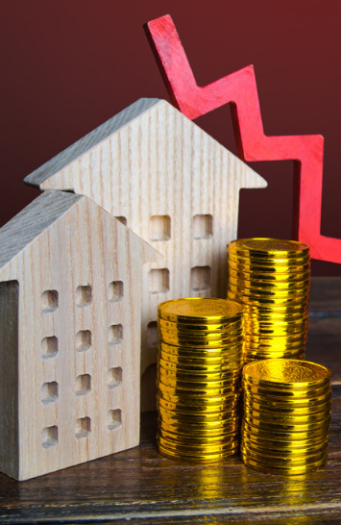
INTRODUCTION
Unlocking the future value of properties through predictive analytics, our house price prediction model revolutionizes real estate insights
Delve into the future of real estate with our advanced house price prediction model. By harnessing the power of data analytics and machine learning algorithms, we accurately forecast property prices, empowering homeowners, investors, and industry professionals to make informed decisions in an ever-evolving market landscape. Stay ahead of the curve and maximize your returns with our cutting-edge predictive technology

Slide 6

The attributes are: 1. price 2. area 3. bedrooms 4. bathrooms 5. Hot water heating 6. air conditioning 7. Parking 8. pref area 9. furnishing status

Slide 7
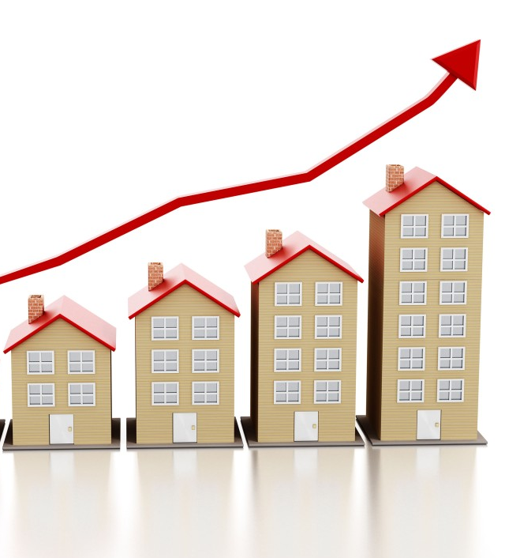
10. rooms 11. stories 12. Main road 13. guestroom 14. basement

Slide 8
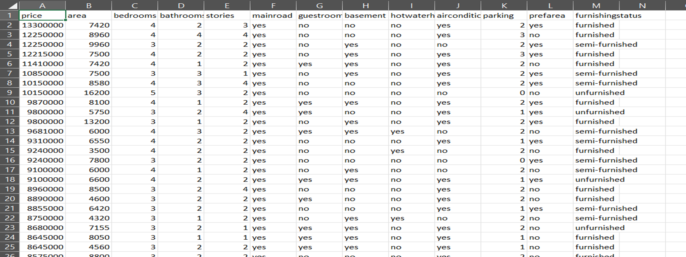
DATA SET

Slide 9

Linear Regression

Slide 10
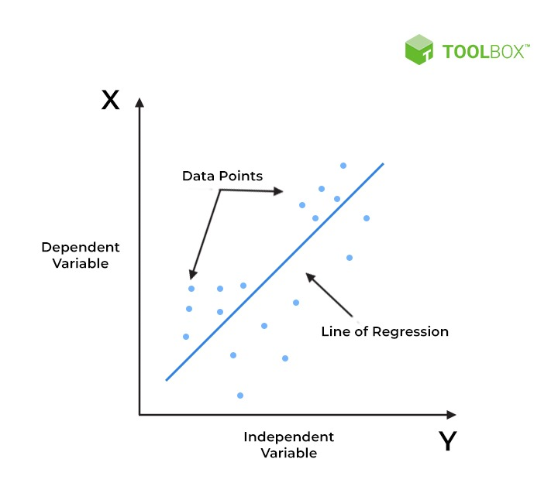
Linear Regression
Linear Regression:
Linear regression is an algorithm that provides a linear relationship between an independent variable and a dependent variable to predict the outcome of future events. It is a statistical method used in data science and machine learning for predictive analysis.

Slide 11
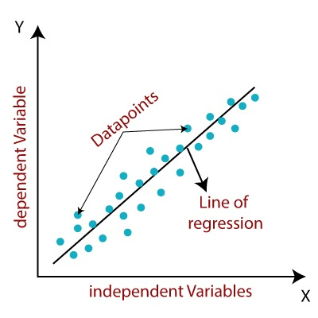
Linear Regression
y= a0+a1x+ ε
Y= Dependent Variable (Target Variable)
X= Independent Variable (predictor Variable)
a0= intercept of the line (Gives an additional degree of freedom)
a1 = Linear regression coefficient (scale factor to each input value).
ε = random error .
The values for x and y variables are training datasets for Linear Regression model representation.

Slide 12
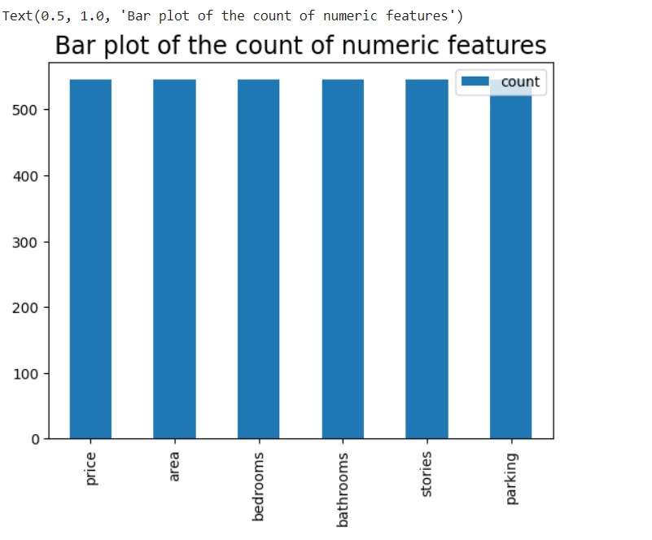
R-squared (R2) score: 0.593939210098702

Slide 13

Support Vector Machine Algorithm
Support Vector Machine or SVM is one of the most popular Supervised Learning algorithms, which is used for Classification as well as Regression problems. However, primarily, it is used for Classification problems in Machine Learning.
The goal of the SVM algorithm is to create the best line or decision boundary that can segregate n-dimensional space into classes so that we can easily put the new data point in the correct category in the future. This best decision boundary is called a hyperplane.
SVM chooses the extreme points/vectors that help in creating the hyperplane. These extreme cases are called as support vectors, and hence algorithm is termed as Support Vector Machine. Consider the below diagram in which there are two different categories that are classified using a decision boundary or hyperplane.
multiple lines/decision boundaries to segregate the classes in n-dimensional space, but we need to find out the best decision boundary that helps to classify the data points. This best boundary is known as the hyperplane of SVM.

Slide 14
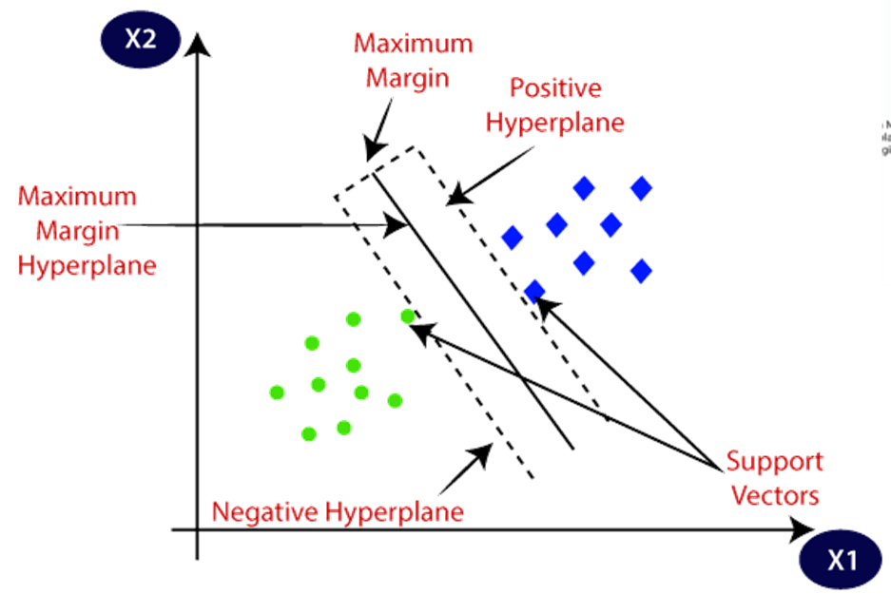
Support Vector Machine Algorithm
The SVM algorithm helps to find the best line or decision boundary; this best boundary or region is called as a hyperplane. SVM algorithm finds the closest point of the lines from both the classes. These points are called support vectors. The distance between the vectors and the hyperplane is called as margin.

Slide 15
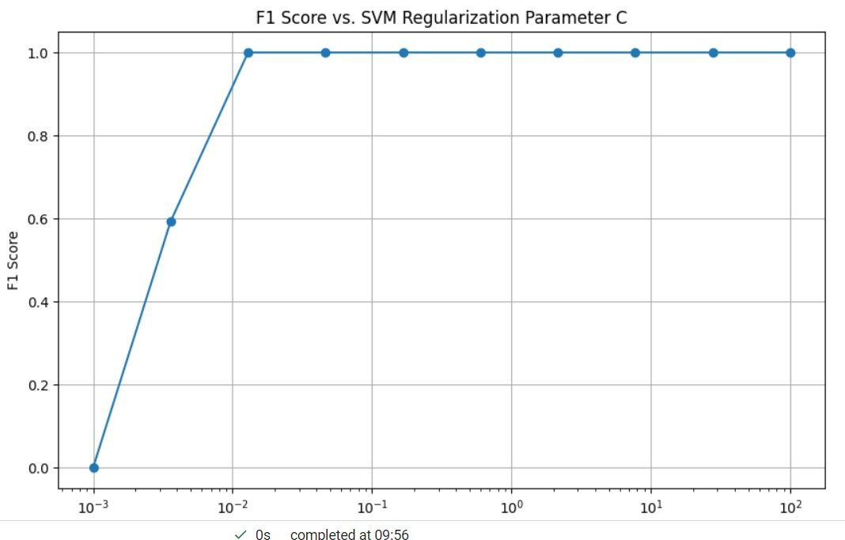
SVM
Accuracy: 0.03048780487804878Precision: 0.000929506246281975/usr/local/lib/python3.10/dist-packages/sklearn/metrics/_classification.py:1344: UndefinedMetricWarning: Precision is ill-defined and being set to 0.0 in labels with no predicted samples. Use zero_division parameter to control this behavior. _warn_prf(average, modifier, msg_start, len(result))
Coefficients: [ 1.00000000e+00 -1.15356846e-16 -1.64399655e-16 1.71642881e-16]Intercept: 3.552713678800501e-15

Slide 16
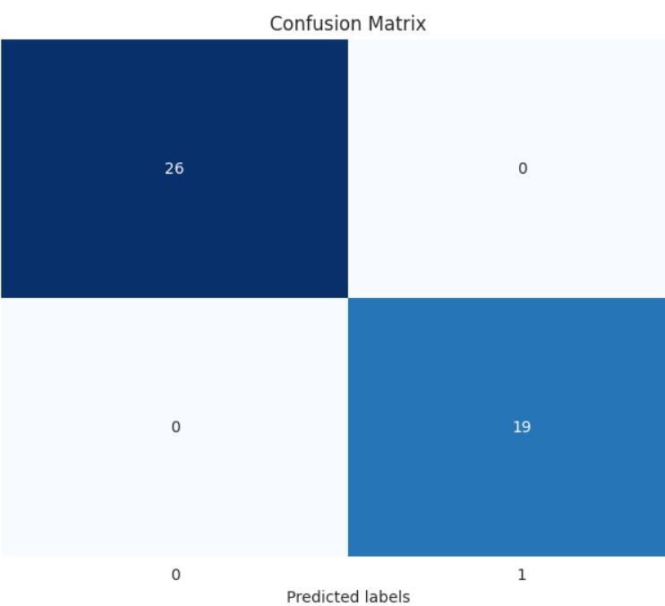
CONFUSION MATRIX
SVM
print(confusion_matrix(y_test,predictions))
[[0 0 0 ... 0 0 0]
[0 0 0 ... 0 0 0]
[0 0 0 ... 0 0 0] ...
[0 0 0 ... 0 0 0]
[0 0 0 ... 0 0 0]
[0 0 0 ... 0 0 0]]

Slide 17

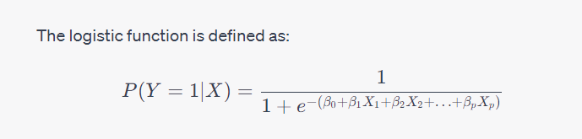
LOGISTIC REGRESSION
Logistic regression is the appropriate regression analysis to conduct when the dependent variable is dichotomous (binary). Like all regression analyses, logistic regression is a predictive analysis. It is used to describe data and to explain the relationship between one dependent binary variable and one or more nominal, ordinal, interval or ratio-level independent variables.

Slide 18
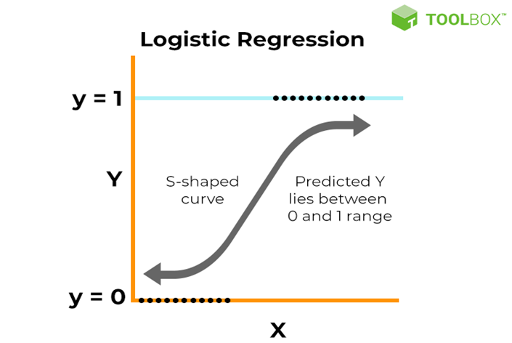
LOGISTIC REGRESSION
The logistic regression model transforms the linear regression function continuous value output into categorical value output using a sigmoid function, which maps any real-valued set of independent variables input into a value between 0 and 1. This function is known as the logistic function.
Mean Squared Error (MSE): 1445620587027.166
Root Mean Squared Error (RMSE): 1202339.6304818226
Accuracy: 1.00
Precision: 1.00

Slide 19
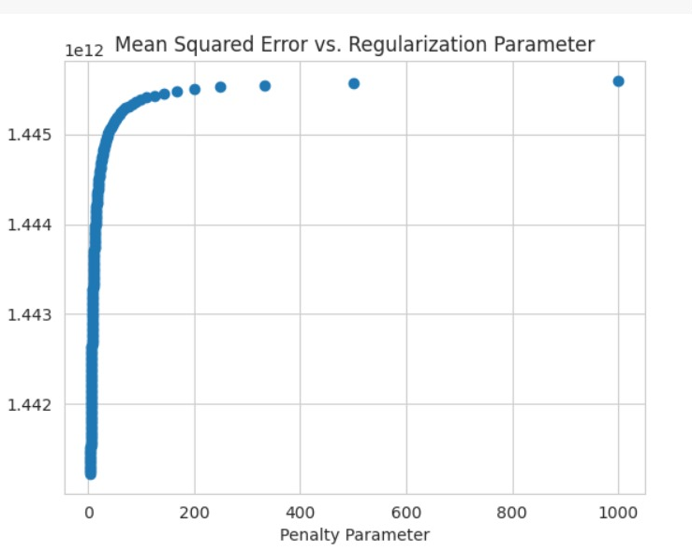
f1 score

Slide 20
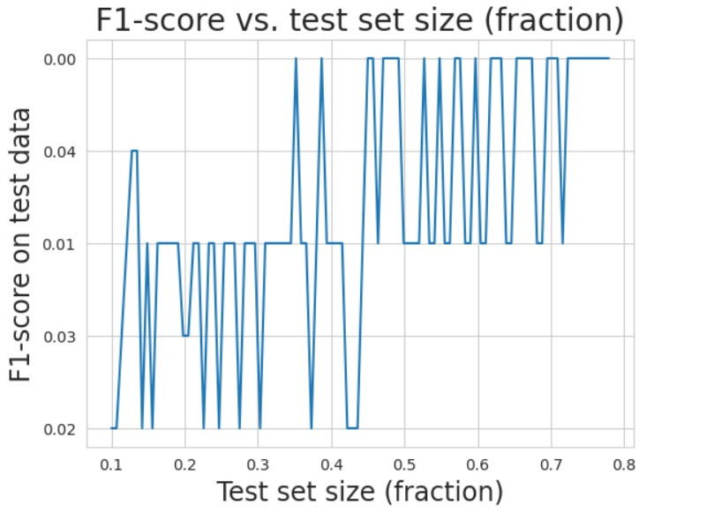
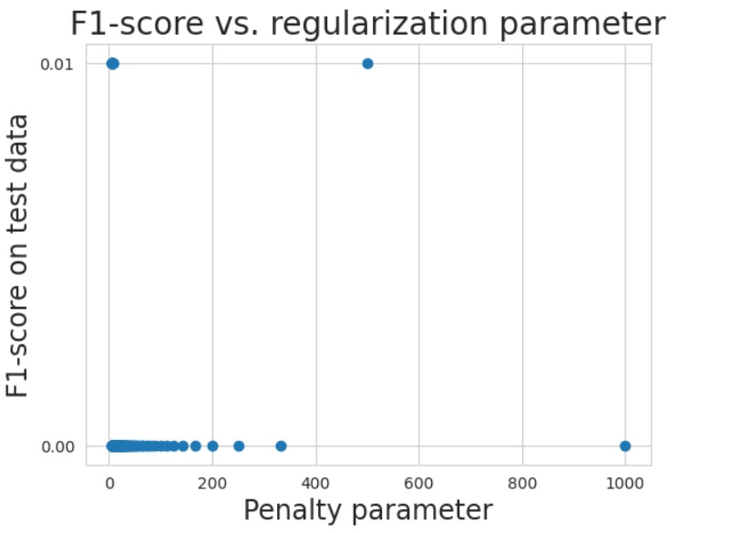
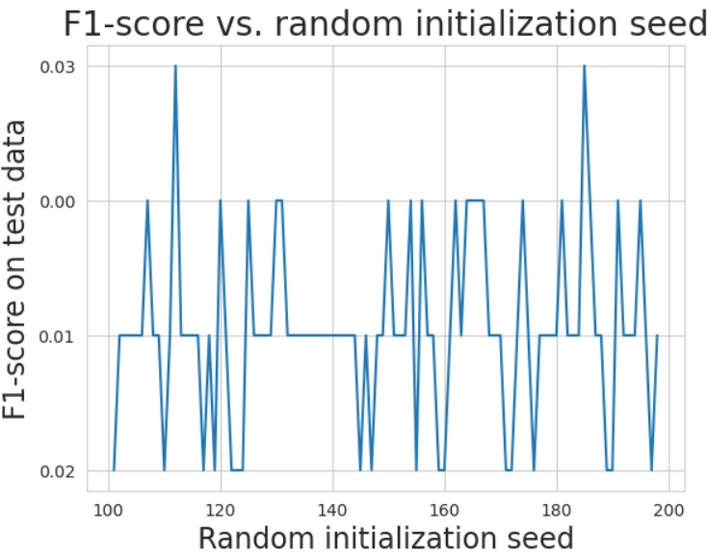
f1 score

Slide 21
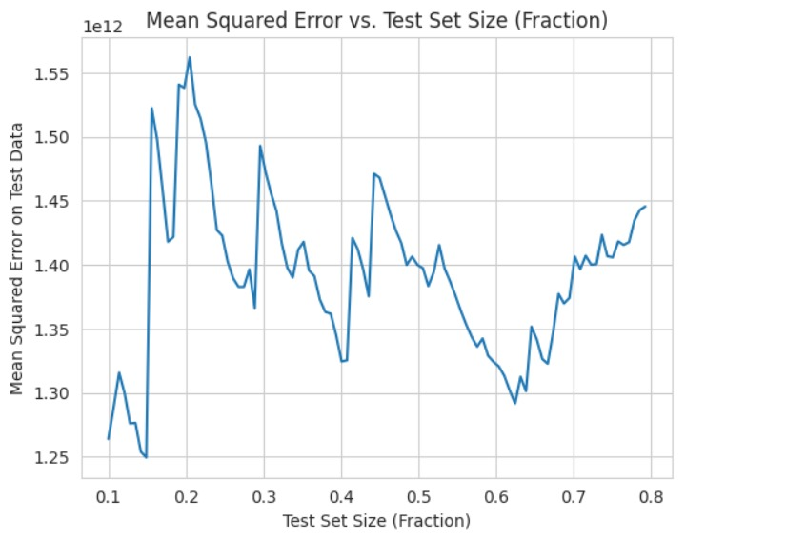
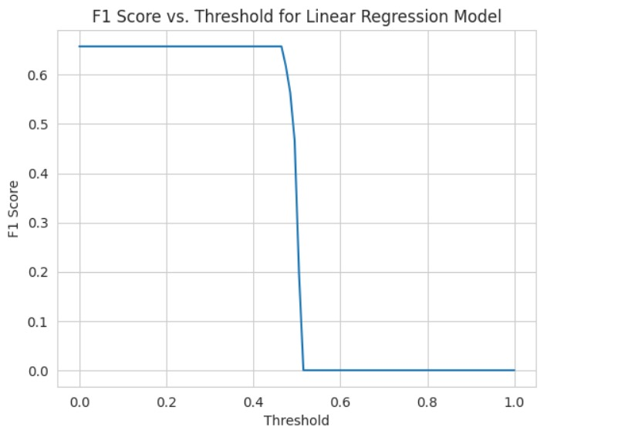
correlation matrix

Slide 22
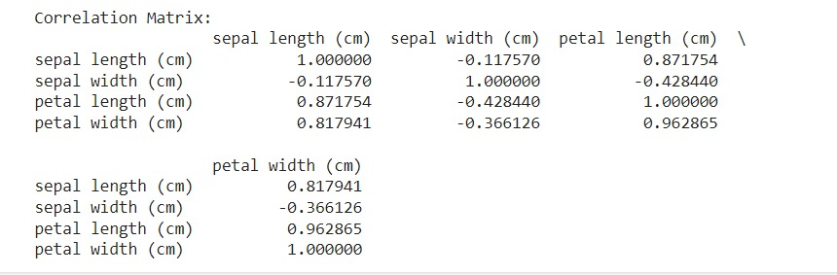
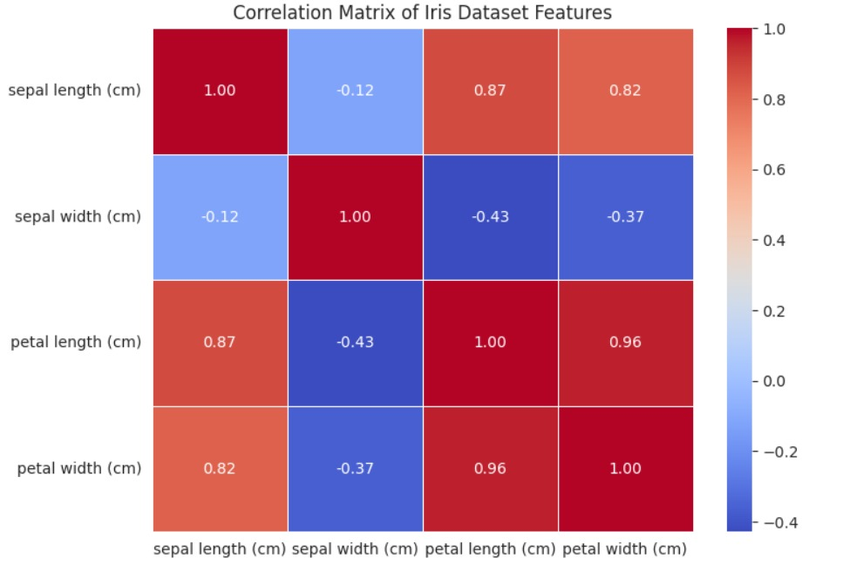

Slide 23
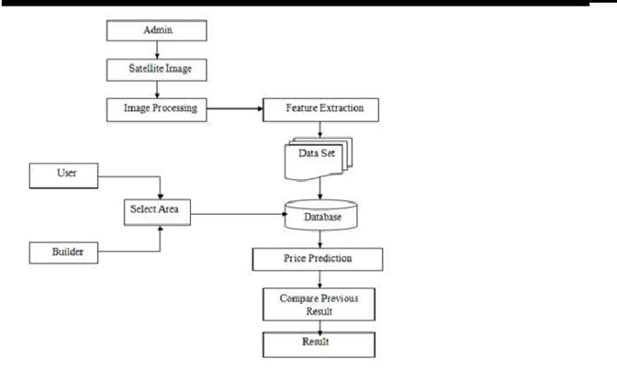

Slide 24
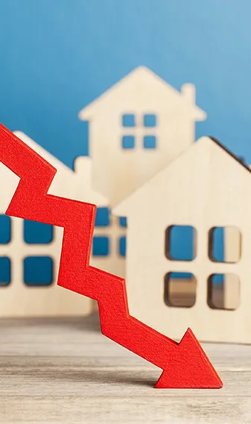

SUMMARY
To predict house prices, you'll need a dataset containing features like square footage, number of bedrooms/bathrooms, location, etc. You can use regression algorithms like linear regression, decision trees, or neural networks to train a model on this data. Make sure to preprocess the data (handling missing values, encoding categorical variables, scaling features) and split it into training and testing sets for evaluation. Then, train your model on the training set, tune hyperparameters if necessary, and evaluate its performance on the testing set using metrics like mean absolute error or mean squared error. Finally, you can deploy the model to make predictions on new data.

Slide 25

THANK YOU

